Slide 1
Digital Logic Design and Application
Lecture #15
Topic 4 - Microprocessors Design

Slide 2
Topic 4 - Microprocessors Design
Chap7&Chap8
Dedicated Microprocessors
  Introduction
  Construct the datapath
  Construct the CU
  Constructing the Complete Microprocessor
Computer Overview
  Architecture vs. Organization
  Function & working principle
  Instruction Set Architecture
RISC CPU Design
  Specification
  ISA design
  Top-down Partition
RISC CPU Implement
  Datapath
  Control Unit
  Testbench & Verify
Chap. 7

Slide 3
Introduction
Chap7
Microprocessor
  General-purpose microprocessor(通用微处理器): are capable of performing a variety of computaions. Each computation is stored in the memory and executed sequentially by the processor. The program can be easily changed to realize different computation.
  Dedicated microprocessor（专用微处理器）: a.k.a. application-specific integrated circuits (ASICs). They are designed to perform only one task. Their function is performed by hardwired circuit not program that implementing a certain algorithm.

Slide 4
Introduction
Design of a microprocessor
  Datapath（数据通路）
    responsible for actual data operation.
    Functional units, registers, buses and other data transfer units.
  Control Unit / Controller(控制单元/控制器)
    Responsible for controlling of operations performed by datapath by generating control signals to the datapath at the appropriate time.
    It is a FSM, by stepping through a sequence of states, the CU automatically controls the operations of the datapath.

Slide 5
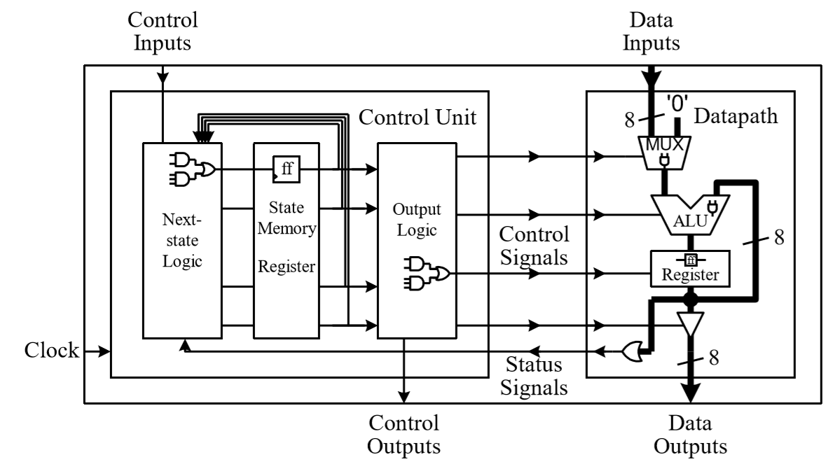
Introduction
Data sel
S1
Output
logic
function sel
Sn
S2
Control
word
…
Cell enable

Slide 6
Topic 4 - Microprocessors Design
Chap7&Chap8
Dedicated Microprocessors
  Introduction
  Construct the datapath
  Construct the CU
  Constructing the Complete Microprocessor
Computer Overview
  Architecture vs. Organization
  Function & working principle
  Instruction Set Architecture
RISC CPU Design
  Specification
  ISA design
  Top-down Partition
RISC CPU Implement
  Datapath
  Control Unit
  Testbench & Verify
Chap. 7

Slide 7
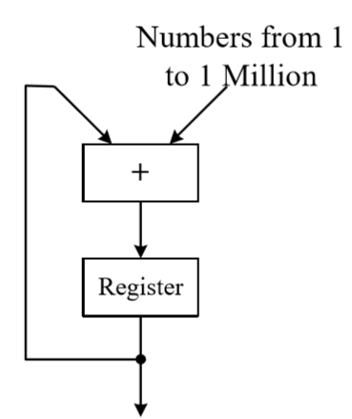
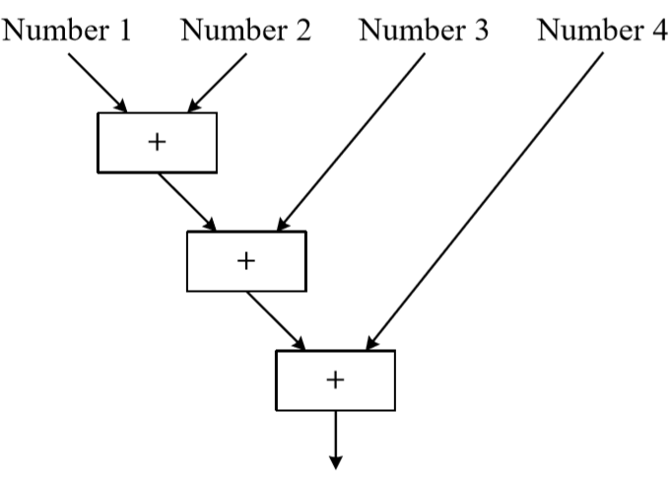
Constructing the datapath
Chap7.1&7.2
Need for a datapath
(a) combinational circuit to add four numbers
(b) datapath to add one million numbers
The scale of the combinational circuits grows with the input number, it may be un-realistic to perform functions involving large number of input.
Functional units in a datapath can be reused and capable of doing many operations by multiple steps.

Slide 8
Constructing the datapath
RTL （寄存器传输级）design
  How data are transferred between registers and modified by combinational units.
  The sequence of data transfer and modification is referred as RTL operation（寄存器传输操作）.
  In each clock cycle a single RTL operation is performed.
operation 1
→operation 2
……
result 1
→ Result 2
……

Slide 9
Constructing the datapath
The complicity of a datapath is decided by the data manipulation statements and conditional tests specified by the algorithm.
In the Datapath design process, we need to decide on the following issues:
  Registers: number, bit-width, access mode
  Functional units: type, number
  Connections between registers and functional units

Slide 10
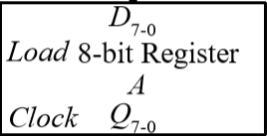
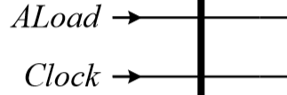
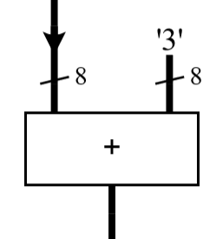
Constructing the datapath
For example, the assignment statement in the algorithm
A = A + 3 (A:8-bit)
din: load the initial
value of A
Aload: load the output of adder into Register A.
8
←rst: clear the register (optional)
CLock: control the updating of the register.
X: stored in another register
Algorithm:
A = A + x
(A:8-bit)
8

Slide 11
Topic 4 - Microprocessors Design
Chap7&Chap8
Dedicated Microprocessors
  Introduction
  Construct the datapath
  Construct the CU
  Constructing the Complete Microprocessor
Computer Overview
  Architecture vs. Organization
  Function & working principle
  Instruction Set Architecture
RISC CPU Design
  Specification
  ISA design
  Top-down Partition
RISC CPU Implement
  Datapath
  Control Unit
  Testbench & Verify
Chap. 7

Slide 12
Construct the CU
A control unit is used to generate the appropriate control signals so that the datapath can perform all of the required register-transfer operations automatically according to the sequence specified in the algorithm.
The correct operation of the datapath involves the correct assertion(有效) or de-assertion of all of the control signals as a group which is called a control word(控制字).
Each control word is executed in one clock cycle to perform one register-transfer operation.
It is the control unit that determines when an register-transfer operation is to be executed and in what order.

Slide 13
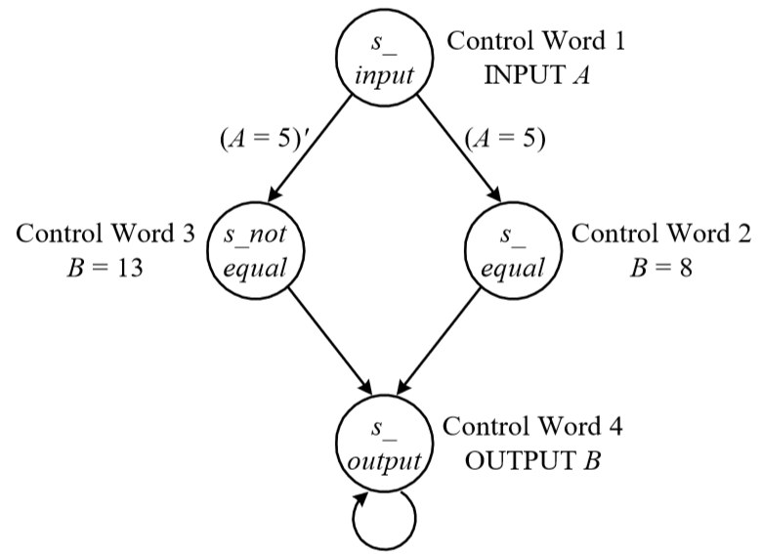
Construct the CU
Chap7.3
Check the instructions or Status feedback signals from datapath to make sure what the next state is.
CU outputs Control Signals to datapath, deciding the routing of data processing and the type of the operation.
state machine step through a sequence of states. The states are decided by the algorithm or the input instructions.

Slide 14
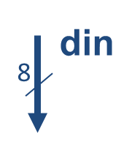
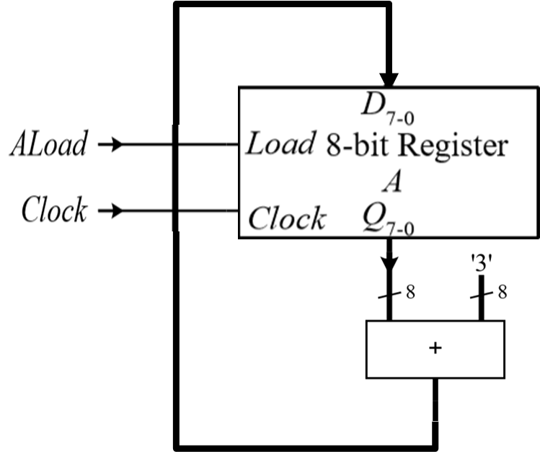
Construct the CU
← Datapath for A=A+3
Aload
Q
the control words for A = A + 3
Out
Ope-ration
Control words
CLK
Q Out
Aload
1
A 0
0
OF
OF： 取操作数
EXE：执行
WB： 写回
2
A A+3
0
EXE
3
A+3 A+3
1
WB

Slide 15
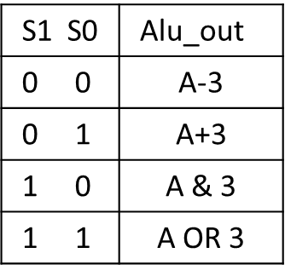
Construct the CU
← Datapath for A=A+3
ALU function table
Aload
Q
2
ALU_sle
ALU
Out
Ope-ration
Control words
CLK
Q Out
Aload
S1 S0
the control words → for A = A + 3
1
A 0
0
X X
OF
2
A A+3
0
0 1
EXE
3
A+3 A+3
1
0 1
WB

Slide 16
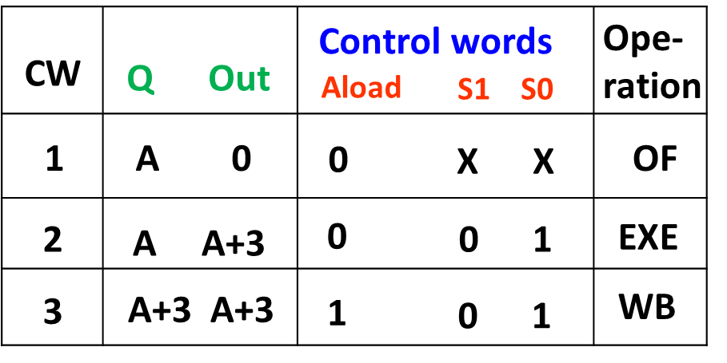
State diagram for A=A+3
OF
control_words_3: 1
01
control_words_1: 0
XX
WB
EXE
control_words_2: 0
01
State diagram for CU can be derived based on the control words.
A more complicated datapath needs a more complicated CU and a longer control word.
Datapath itself do not show the order of operations. It is the CU control the operation sequences.

Slide 17
Construct the CU
Control Unit circuit diagram for algorithm A=A+3
* Use gray coded states and minimal risk method
D1 Q1
A_laod
Clk
Q1
D0 Q0
S0
Q0
S1=0
This is a Moore CU.

Slide 18
Construct the CU
Once the state diagram for a CU is determined,
  The circuit for CU can be synthesized manually.
  The circuit for CU can be designed by Verilog HDL on behavioral level and then synthesized by EDA tool automatically.
A CU can be designed as a Moore or a Mealy FSM.

Slide 19
Verilog for dedicated CU
S_input:
begin
if (A==5) begin
cw<=cw1; Next_state<=s_equal; end
else begin
cw<=cw1; Next_state<= s_notequal; end
end
// check input in each case brantch and assign the next state and the current outputs.
Case (current_state)
begin
S_input: ……
……
S_not equal:……
Default： 。。。。。
endcase
// use case statement within an always statement for state transitions.
This is a moore FSM

Slide 20
Topic 4 - Microprocessors Design
Chap7&Chap8
Dedicated Microprocessors
  Introduction
  Construct the datapath
  Construct the CU
  Constructing the Complete Microprocessor
Computer Overview
  Architecture vs. Organization
  Function & working principle
  Instruction Set Architecture
RISC CPU Design
  Specification
  ISA design
  Top-down Partition
RISC CPU Implement
  Datapath
  Control Unit
  Testbench & Verify
Chap. 7

Slide 21
Constructing the Complete Microprocessor
connect the datapath and the control unit together by control signals and feedback signals to produce a complete microprocessor.
inputs
Control
Unit
Datapath
Control
word
Statas
signals
outputs

Slide 22
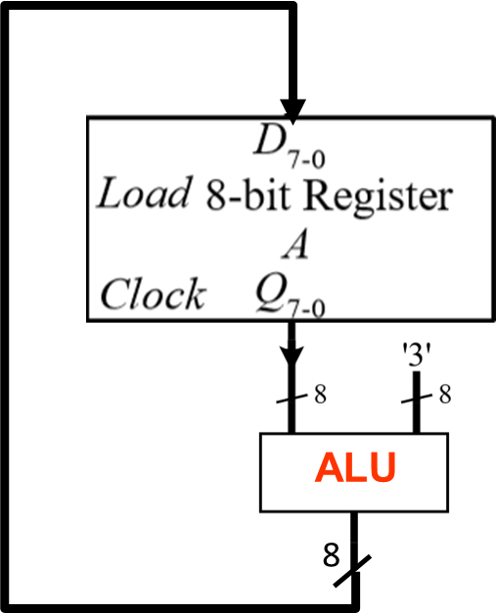
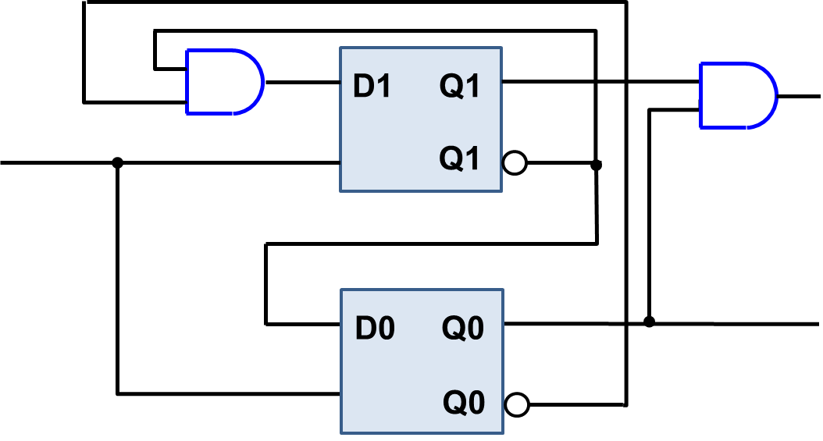
Constructing the Complete Microprocessor
The dedicated processor for algorithm A=A+3
A_laod
CLK
S0
S1=0
No feedback from datapath for this circuit.

Slide 23
Design of a Dedicated Microprocessor
Construct the dedicated datapath according to the algorithm.
Determine the control word by datapath.
Design the control unit according to the RTL operations and control words needed by datapath.
connect the datapath and the control unit together by control signals and feedback signals to produce a complete microprocessor.

Slide 24
Required reading
  Computer Organization and Architecture Design for Performance
  William Stallings, 8th Edition
      Chapter 3, A Top-level View of Computer Function and Interconnection
      Chapter 9, Computer Arithmetic
      Chapter 10, Instruction Sets: Characteristics and Functions
      Chapter 11, Instruction Sets: Addressing Modes and Formats
      Chapter 12, Processor Structure and Function
      Chapter 15, Control Unit Operation
  微处理器系统原理与嵌入式系统设计（第二版） 李广军，阎波等, 电子工业出版社
      Chapter 2，计算机系统的结构组成与工作原理
      Chapter 3，微处理器体系结构及关键技术
  数字系统设计（Verilog and VHDL）Enoch O Hwang，电子工业出版社
      Chapter 7

